Slide 1
AA Asg 2
Dominic Lee (Individual)

Slide 2

Data Pre-Processing
Download text
Cleanse Text
Transform text

Slide 3

Data Understanding
Extract keywords using TF-IDF matrix
Using visualizations such as Word Cloud and Bar graphs to further understand the data
Analyze the extracted keywords using Associate Rule mining

Slide 4


Clean Text

Slide 5
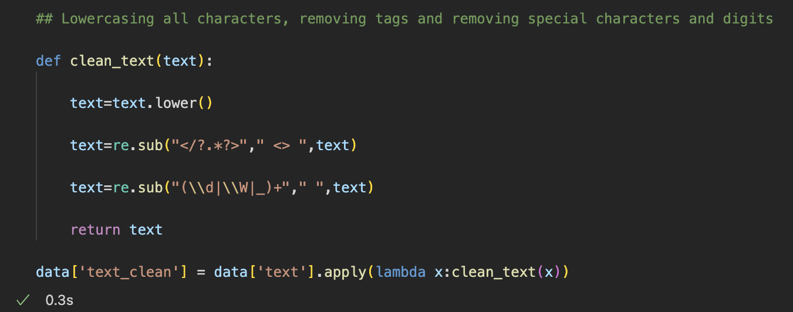
Tags and special characters
.lower() lower cases the words
Used Regex to remove tags and special characters
These characters add no value to helping the model predict the label
They add noise which can make the model confused and predict worse

Slide 6
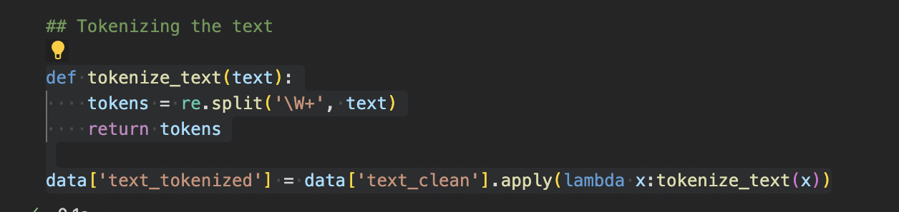
Tokenization
Tokenized the text to prepare for lemmatization and removal of stop words

Slide 7
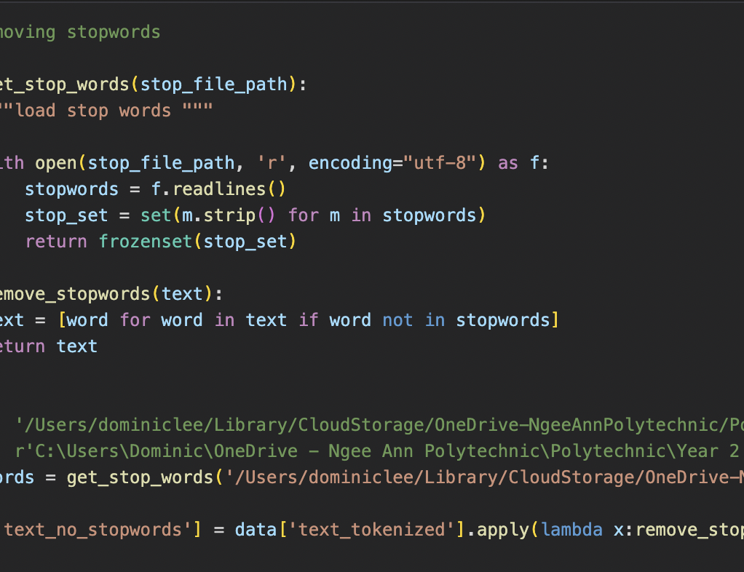
Stopwords
Remove stopwords as they do not contribute to the meaning of the sentence
Adds noise for the model

Slide 8
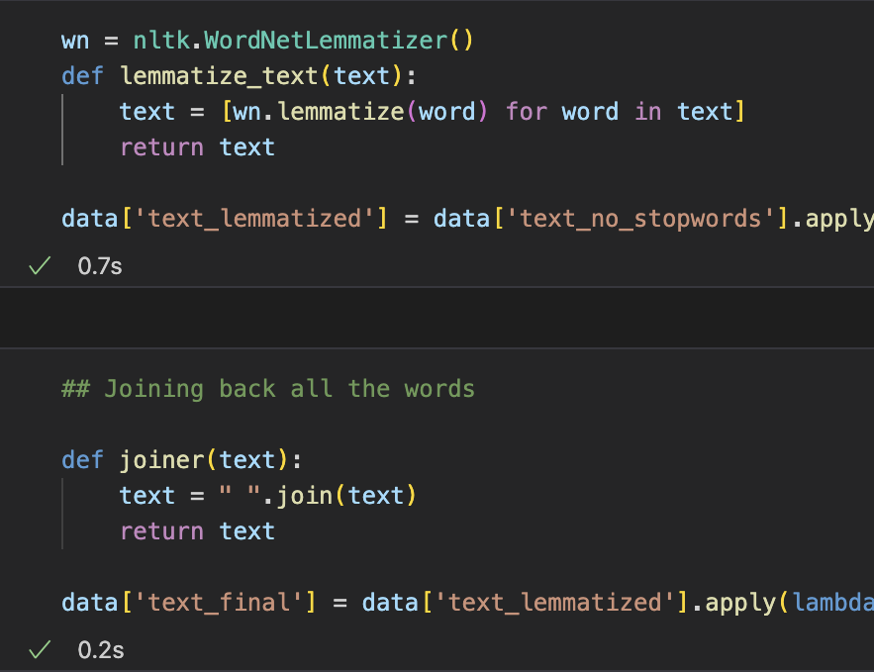
Lemmatization
Converts words back to their base form e.g. works → work
Reduces noise and increases model’s speed
Takes context of sentence into account
More accurate and meaningful conversions

Slide 9
Transform Text

Slide 10
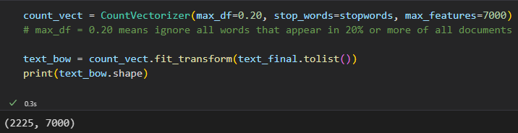
Bag of words
Converted the cleaned df into a sparse matrix
Max_df removes words that appear too frequently
Max_features is the number of words that I want to work with

Slide 11
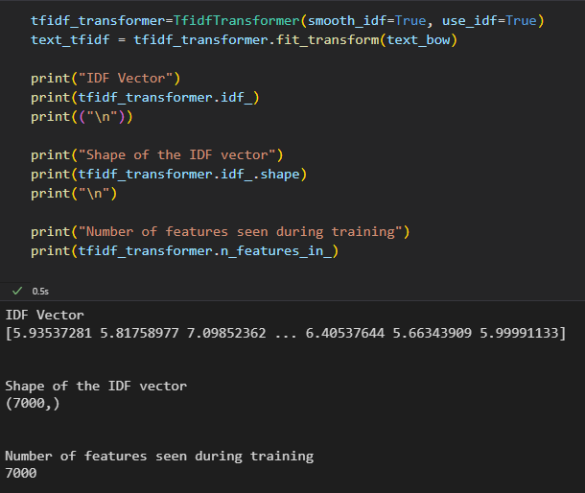
Tf-idf
Transformed the BOW matrix into a TF-IDF matrix
Smooth_idf ensures no zero division

Slide 12
Extracting Keywords

Slide 13
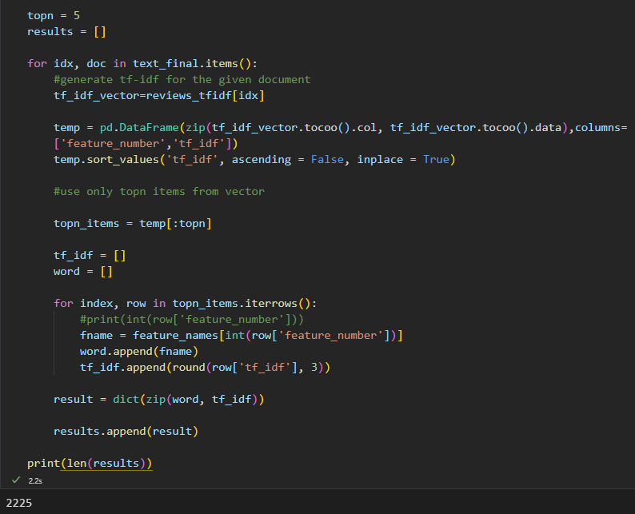
Extracting keywords
Extracting top 5 words with highest TF-IDF value for each document
This way, we can find out which words gives the most context to the document

Slide 14
Visualizations

Slide 15
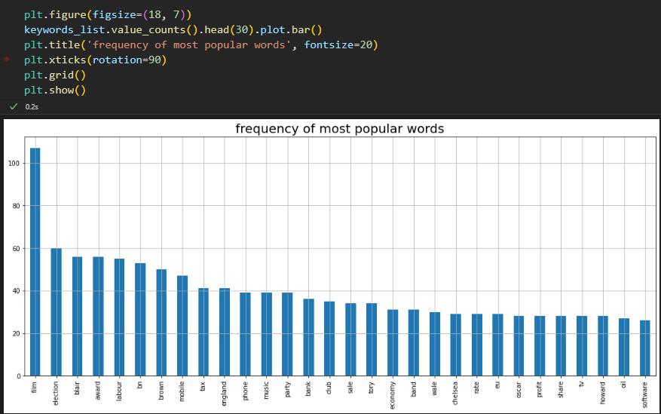
Bar CHart
Gives us the 30 keywords with highest frequencies
Better understanding on which keywords have a larger impact on their respective documents

Slide 16
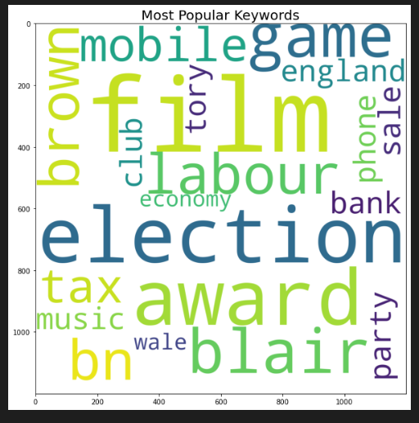
Word Cloud
Bigger words = More frequent
Good intuitive high-level way of visualizing most popular words
Not so good at a more granular level

Slide 17
ARM Individual categories

Slide 18
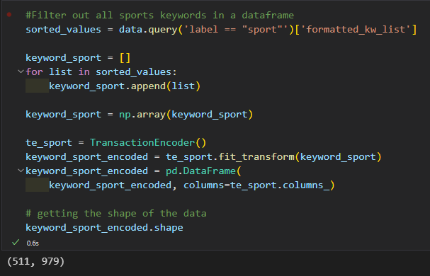
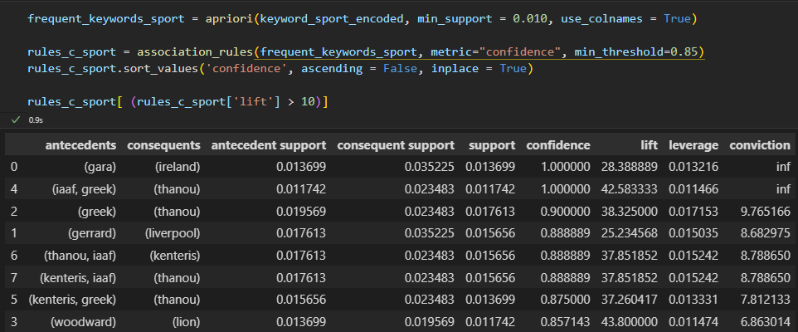
Individual ARM Code
Left ss shows how to extract and encode the individual categories
Right ss shows the frequent itemset and rules generation

Slide 19
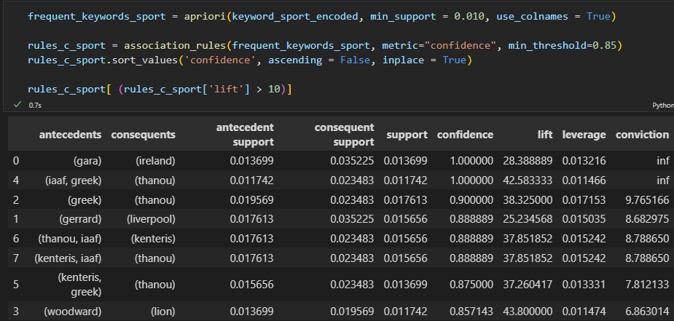
Insights (Sports)
Documents with the highest support always talk about athletes and not the sport itself
The Athlete is often associated with his country of origin
Controversies and news about athletes are also popular

Slide 20
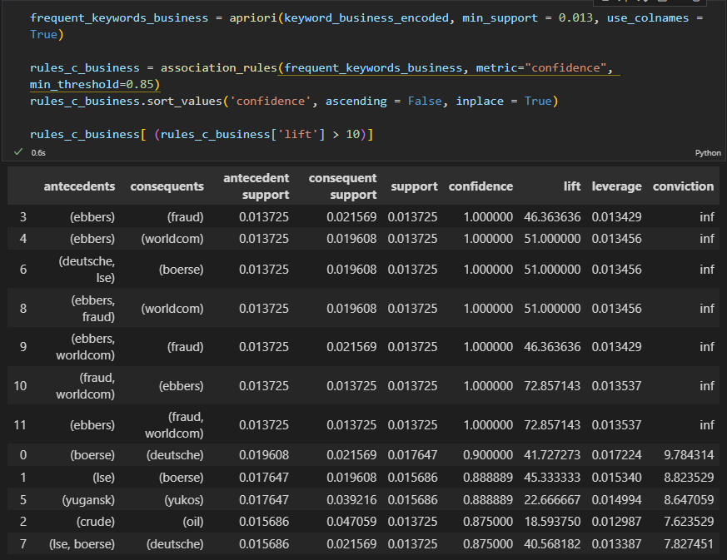
Insights (Business)
Documents with highest support mostly talk about large companies
Oil is the only non-company associated rule
Events discussed are often when a big company collapses or makes a major move

Slide 21
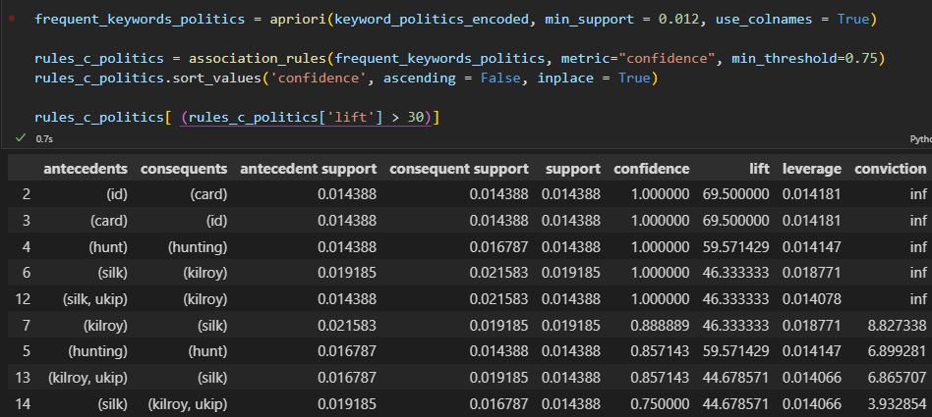
Insights (politics)
Rules generated were either on politicians or on ethical issues
When politicians get cancelled
Issues such as hunting and id cards were the most relevant

Slide 22
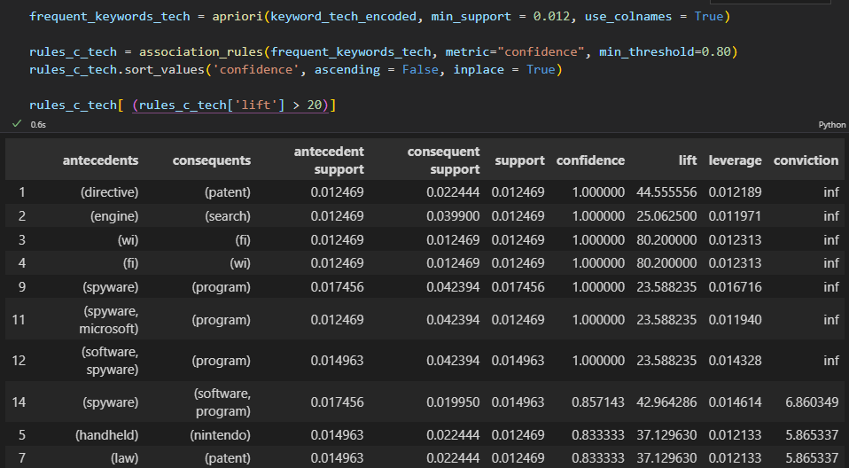
Insights (Tech)
Rules generated either were for popular gadgets/technology or for patenting law.
Spyware is the most talked about topic

Slide 23
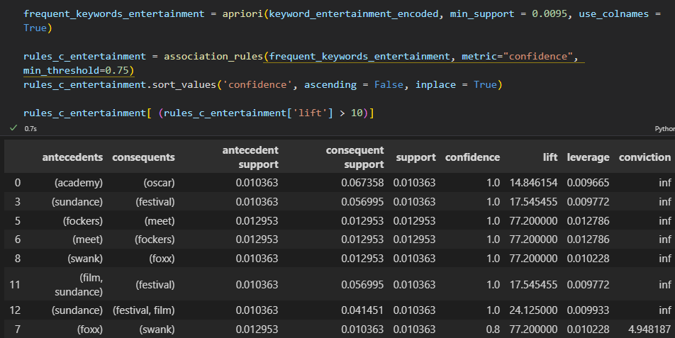
Insights (entertainment)
Rules generated include festivals, shows and actors/actresses
Meet the fockers box office hit
Swank, Foxx extremely popular actor/actress duo
Oscar most prestigious award show

Slide 24
Associate Rule Mining

Slide 25
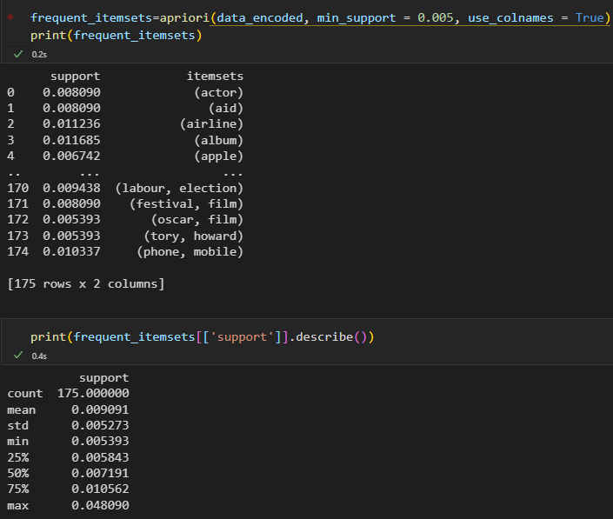
Generate Frequent itemsets
Support threshold of 0.5% was used
Filtered out items which were present in < 0.5% of all documents

Slide 26
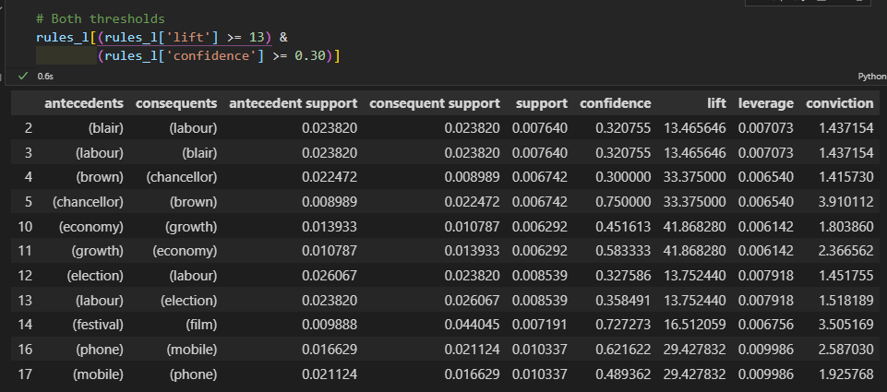
Insights (overall)
Rules with highest support belong in categories
Politics, tech, economics, entertainment
News about politics talks about well known politicians
Economics talks about where the economy is heading (growth)
Entertainment and tech are more specific
Mobile phone and film festivals

